Slide 1
Chapter 11: Indexing and Hashing

Slide 2
Chapter 12: Indexing and Hashing
Basic Concepts
Ordered Indices
B⁺-Tree Index Files
B-Tree Index Files
Static Hashing
Dynamic Hashing
Comparison of Ordered Indexing and Hashing
Index Definition in SQL
Multiple-Key Access

Slide 3
Basic Concept
Many queries reference only a small proportion of the records in a file.
For example,
“Find all instructors in the Physics department” or
“Find the total number of credits earned by the student with ID 22201”
It is inefficient for the system to read every tuple in the instructor relation to check if the dept name value is “Physics”.
Likewise, it is inefficient to read the entire student relation just to find the one tuple for the ID “22201”.
Ideally, the system should be able to locate these records directly. To allow these forms of access, we design additional structures (index) that we associate with files.
The index structure is much smaller than the original relation.

Slide 4
Basic Concept
An index for a file in a database system works in much the same way as the index in the textbook.
Database-system indices play the same role as book indices in libraries.
For example, to retrieve a student record given an ID, the database system would look up an index to find on which disk block the corresponding record resides, and then fetch the disk block, to get the appropriate student record.
There are two basic kinds of indices:
Ordered indices. Based on a sorted ordering of the values.
Hash indices. Based on a uniform distribution of values across a range of buckets. The bucket to which a value is assigned is determined by a function, called a hash function.
Several techniques exist for both ordered indexing and hashing. No one technique is the best. Rather, each technique is best suited to particular database applications.

Slide 5
Index Evaluation Metrics
Each technique must be evaluated on the basis of these factors:
Access types: The types of access that are supported efficiently. Access types can include finding records with a specified attribute value (point query) and finding records whose attribute values fall in a specified range (range query).
Access time: The time it takes to find a particular data item, or set of items, using the technique in question.
Insertion time: The time it takes to insert a new data item. This value includes the time it takes to find the correct place to insert the new data item, as well as the time it takes to update the index structure.
Deletion time: The time it takes to delete a data item. This value includes the time it takes to find the item to be deleted, as well as the time it takes to update the index structure.
Space overhead: The additional space occupied by an index structure. Provided that the amount of additional space is moderate, it is usually worthwhile to sacrifice the space to achieve improved performance.

Slide 6
Basic Concepts
Indexing mechanism is used to speed up access to desired data.
E.g., author catalog in library
We often want to have more than one index for a file.
E.g., we may wish to search for a book by author, by subject, or by title.
Search Key – An attribute or set of attributes used to look up records in a file.
This definition of key differs from that used in primary key, candidate key, and superkey.
Using this notion of a search key, if there are several indices on a file, there are several search keys.
An index file consists of records (called index entries) of the form
search-key
pointer

Slide 7
Ordered Indices
To gain fast random access to records in a file, an index structure is used.
Each index structure is associated with a particular search key.
The records in the indexed file may themselves be stored in some sorted order.
A file may have several indices, on different search keys.
In an ordered index, index entries are stored sorted on the search key value. E.g., author catalog in library.
Primary index: If the file containing the records is sequentially ordered, a Primary index is an index whose search key also defines the sequential order of the file.
Also called clustering index
The search key of a clustering index is often the primary key, although that is NOT necessarily so.
Secondary index: an index whose search key specifies an order different from the sequential order of the file. Also called non-clustering index.
Index-sequential file: ordered sequential file with a primary index.

Slide 8
Classification of Indexing
Indexing
Primary / Clustering
Dense
Sparse
Secondary / Non-Clustering
Dense

Slide 9
Dense and Sparse Indices
An index entry, or index record, consists of a search-key value and pointers to one or more records with that value as their search-key value.
The pointer to a record consists of the identifier of a disk block and an offset within the disk block to identify the record within the block.
There are two types of ordered indices: 1. Dense Index, 2. Sparse Index
Dense index: In a dense index, an index entry appears for every search-key value in the file.
In a dense clustering index, the index record contains the search-key value and a pointer to the first data record with that search-key value. The rest of the records with the same search-key value would be stored sequentially after the first record, since, because the index is a clustering one, records are sorted on the same search key.
In a dense non-clustering index, the index must store a list of pointers to all records with the same search-key value.

Slide 10
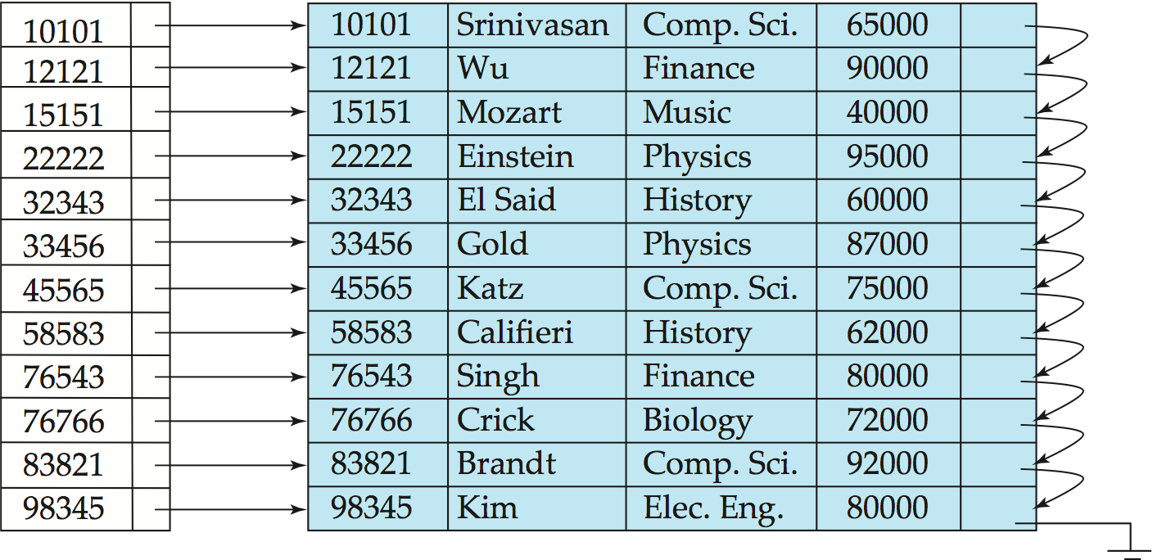
Dense Index Files
Dense index — Index record appears for every search-key value in the file.
E.g. index on ID attribute of instructor relation

Slide 11
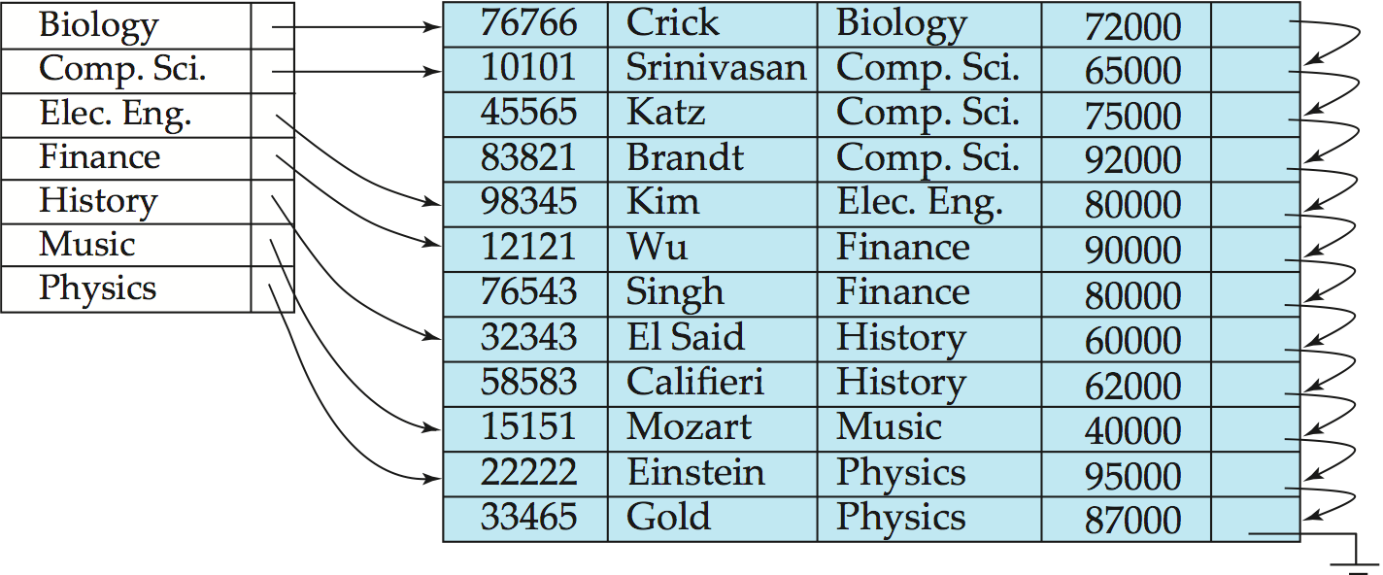
Dense Index Files (Cont.)
Dense index on dept_name, with instructor file sorted on dept_name

Slide 12
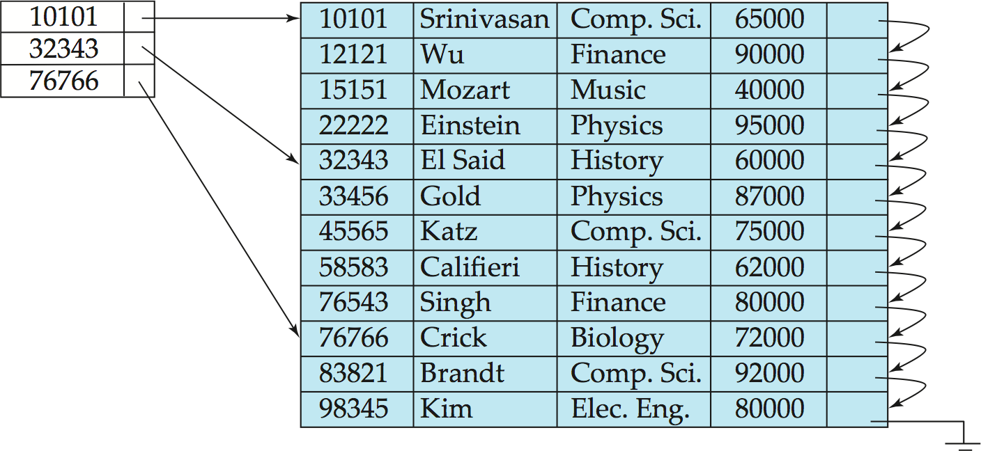
Sparse Index Files
Sparse Index: contains index records for only some of the search-key values. Sparse indices can be used only if the index is a clustering index. Like dense index, each index entry contains a search-key value and a pointer to the first data record with that search-key value
To locate a record with search-key value K we:
Find index record with largest search-key value < K
Search file sequentially starting at the record to which the index record points

Slide 13
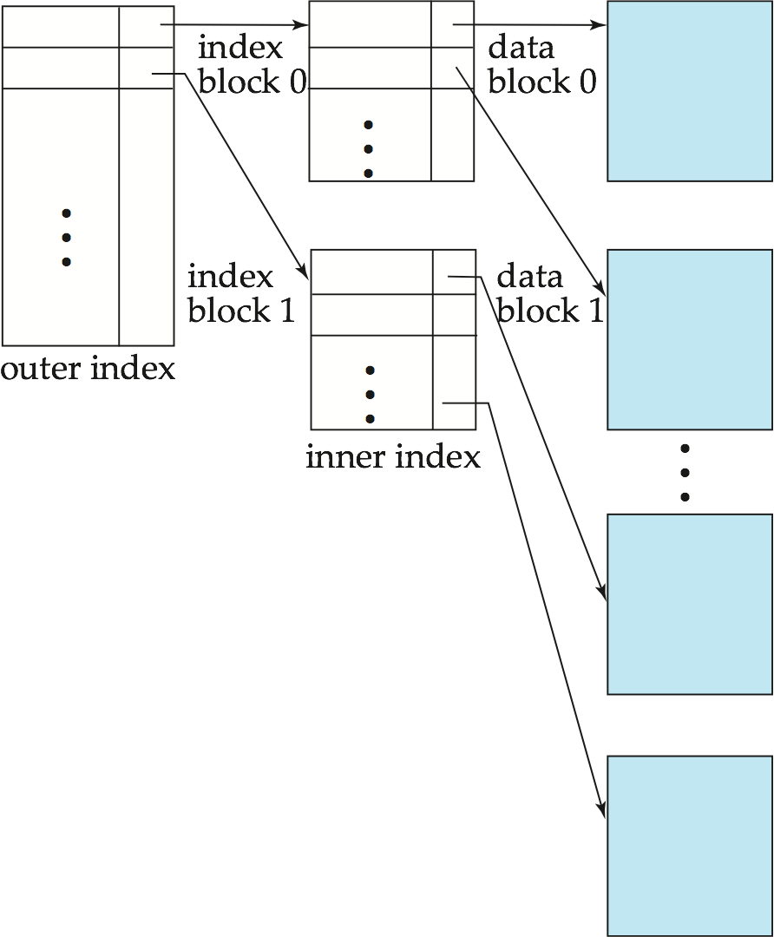
Dense Vs Sparse Indices
Compared to dense indices:
Less space and less maintenance overhead for insertions and deletions.
Generally slower than dense index for locating records.
Good tradeoff: sparse index with an index entry for every block in file, corresponding to least search-key value in the block.
The reason this design is a good trade-off is that the dominant cost in processing a database request is the time that it takes to bring a block from disk into main memory. Once the block has been brought in, the time to scan the entire block is negligible.
Using this sparse index, we locate the block containing the record that we are seeking. Thus, unless the record is on an overflow block, we minimize block accesses while keeping the size of the index (and thus our space overhead) as small as possible.

Slide 14
Secondary Indices
Frequently, one wants to find all the records whose values in a certain field (which is not the search-key of the primary index) satisfy some condition.
Example 1: In the instructor relation stored sequentially by ID, we may want to find all instructors in a particular department
Example 2: as above, but where we want to find all instructors with a specified salary or with salary in a specified range of values
We can have a secondary index with an index record for each search-key value

Slide 15
Secondary Indices
Secondary indices must be dense, with an index entry for every search-key value, and a pointer to every record in the file.
A clustering index may be sparse, storing only some of the search-key values, since it is always possible to find records with intermediate search-key values by a sequential access to a part of the file.
If a secondary index stores only some of the search-key values, records with intermediate search-key values may be anywhere in the file and, in general, we cannot find them without searching the entire file.
A secondary index on a candidate key looks just like a dense clustering index, except that the records pointed to by successive values in the index are not stored sequentially.
In general, however, secondary indices may have a different structure from clustering indices.

Slide 16
Secondary Indices are always Dense
If the search key of a clustering index is not a candidate key, it suffices if the index points to the first record with a particular value for the search key, since the other records can be fetched by a sequential scan of the file.
In contrast, if the search key of a secondary index is not a candidate key, it is not enough to point to just the first record with each search-key value.
The remaining records with the same search-key value could be anywhere in the file, since the records are ordered by the search key of the clustering index, rather than by the search key of the secondary index. Therefore, a secondary index must contain pointers to all the records.
We can use an extra level of indirection to implement secondary indices on search keys that are not candidate keys. The pointers in such a secondary index do not point directly to the file. Instead, each points to a bucket that contains pointers to the file.

Slide 17
Secondary Indices
A sequential scan in clustering index order is efficient because records in the file are stored physically(?) in the same order as the index order.
Because secondary-key order and physical-key order differ, if we attempt to scan the file sequentially in secondary-key order, the reading of each record is likely to require the reading of a new block from disk, which is very slow.
Secondary indices improve the performance of queries that use keys other than the search key of the clustering index. However, they impose a significant overhead on modification of the database.
The designer of a database decides which secondary indices are desirable on the basis of an estimate of the relative frequency of queries and modifications.

Slide 18
Secondary Indices Example
Secondary index on salary field of instructor
Index record points to a bucket that contains pointers to all the actual records with that particular search-key value.
Secondary indices have to be dense
Notes:
18

Slide 19
Primary and Secondary Indices
Indices offer substantial benefits when searching for records.
BUT: Updating indices imposes overhead on database modification --when a file is modified, every index on the file must be updated,
Sequential scan using primary index is efficient, but a sequential scan using a secondary index is expensive
Each record access may fetch a new block from disk
Block fetch requires about 5 to 10 milliseconds, versus about 100 nanoseconds for memory access
Notes:
19

Slide 20
Multilevel Index, Why?
Suppose a dense index is built on a relation with 1,000,000 tuples. Index entries are smaller than data records, so let us assume that 100 index entries fit on a 4 kilobyte block. Thus, our index occupies 10,000 blocks. If the relation instead had 100,000,000 tuples, the index would instead occupy 1,000,000 blocks, or 4 gigabytes of space. Such large indices are stored as sequential files on disk.
If an index is small enough to be kept entirely in main memory, the search time to find an entry is low. However, if the index is so large that not all of it can be kept in memory, index blocks must be fetched from disk when required.
Again main memory is also required for a number of other tasks. The search for an entry in the index then requires several disk-block reads.

Slide 21
Multilevel Index, Why?
Binary search can be used on the index file to locate an entry, but the search still has a large cost. If the index would occupy b blocks, binary search requires as many as log₂(b) blocks to be read.
For a 10,000-block index, binary search requires 14 block reads.
On a disk system where a block read takes on average 10 milliseconds, the index search will take 140 milliseconds. This may not seem much, but we would be able to carry out only seven (7) index searches a second, whereas a more efficient search mechanism would let us carry out far more searches per second.
But, if overflow blocks have been used, binary search is only possible on non-overflow blocks and actual cost may be higher.
A sequential search requires b sequential block reads, which may take even longer.
Thus, the process of searching a large index may be costly.

Slide 22
Multilevel Index
If primary index does not fit in memory, access becomes expensive.
Solution: treat primary index kept on disk as a sequential file and construct a sparse index on it.
outer index – a sparse index of primary index
inner index – the primary index file
In earlier example, an inner index with 10,000 blocks would require 10,000 entries in the outer index, which would occupy just 100 blocks. If we assume that the outer index is already in main memory, we would read only one index block for a search using a multilevel index, rather than the 14 blocks we read with binary search.
Thus, we can perform 14 times as many index searches per second
If even outer index is too large to fit in main memory, yet another level of index can be created, and so on. Indices with two or more levels are called multilevel indices. Searching for records with a multilevel index requires significantly fewer I/O operations than does searching for records by binary search.
Indices at all levels must be updated on insertion or deletion from the file.

Slide 23
Multilevel Index (Cont.)

Slide 24
Index Update: Deletion (Book)
If deleted record was the only record in the file with its particular search-key value, the search-key is deleted from the index also.
Single-level index entry deletion:
Dense indices – deletion of search-key is similar to file record deletion.
Sparse indices –
if an entry for the search key exists in the index, it is deleted by replacing the entry in the index with the next search-key value in the file (in search-key order).
If the next search-key value already has an index entry, the entry is deleted instead of being replaced.

Slide 25
Index Update: Insertion (Book)
Single-level index insertion:
Perform a lookup using the search-key value that appears in the record to be inserted.
Dense indices – if the search-key value does not appear in the index, insert it.
Sparse indices – if index stores an entry for each block of the file, no change needs to be made to the index unless a new block is created.
If a new block is created, the first search-key value appearing in the new block is inserted into the index.
Multilevel insertion and deletion: algorithms are simple extensions of the single-level algorithms

Slide 26
Multiple-Key Access
Use multiple indices for certain types of queries.
Example:
select ID
from instructor
where dept_name = “Finance” and salary = 80000
Possible strategies for processing query using indices on single attributes:
1. Use index on dept_name to find instructors with department name Finance; test salary = 80000
2. Use index on salary to find instructors with a salary of $80000; test dept_name = “Finance”.
3. Use dept_name index to find pointers to all records pertaining to the “Finance” department. Similarly use index on salary. Take intersection of both sets of pointers obtained.

Slide 27
Indices on Multiple Keys
Composite search keys are search keys containing more than one attribute
E.g. (dept_name, salary)
Lexicographic ordering: (a₁, a₂) < (b₁, b₂) if either
a₁ < b₁, or
a₁=b₁ and a₂ < b₂

Slide 28
Indices on Multiple Attributes
Suppose we have an index on combined search-key
(dept_name, salary).
With the where clause where dept_name = “Finance” and salary = 80000 the index on (dept_name, salary) can be used to fetch only records that satisfy both conditions.
Using separate indices is less efficient — we may fetch many records (or pointers) that satisfy only one of the conditions.
Can also efficiently handle where dept_name = “Finance” and salary < 80000
But cannot efficiently handle where dept_name < “Finance” and salary = 80000
May fetch many records that satisfy the first but not the second condition

Slide 29
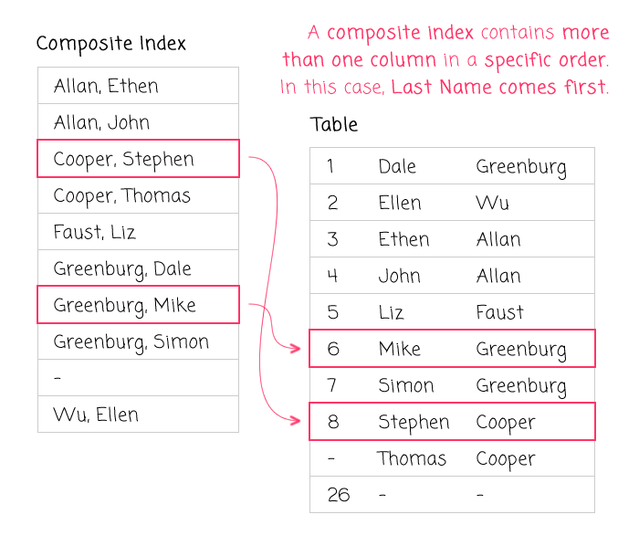
Images of Indices

Slide 30
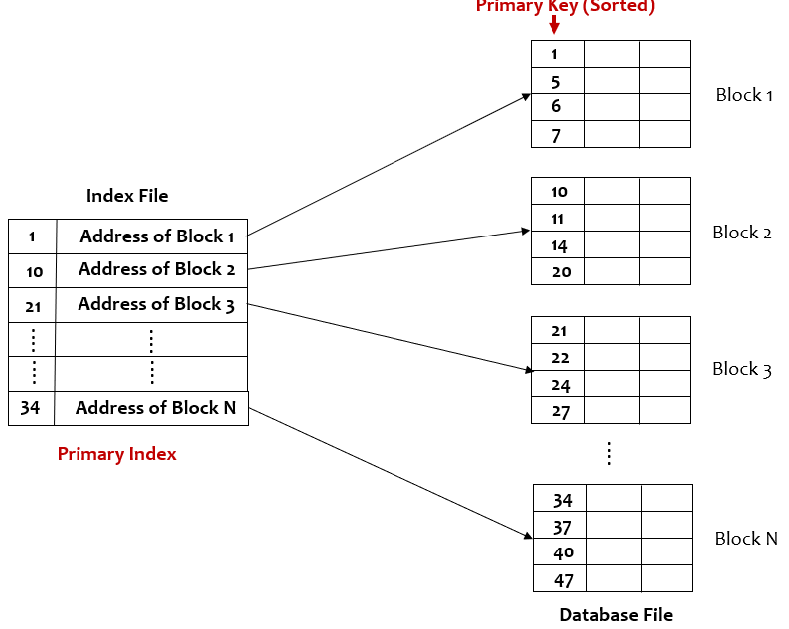
Images of Indices

Slide 31
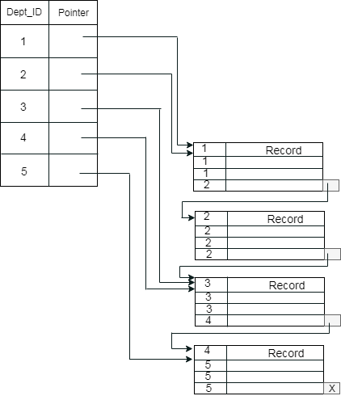
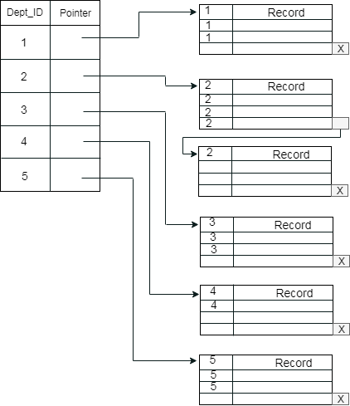
Images of Indices

Slide 32
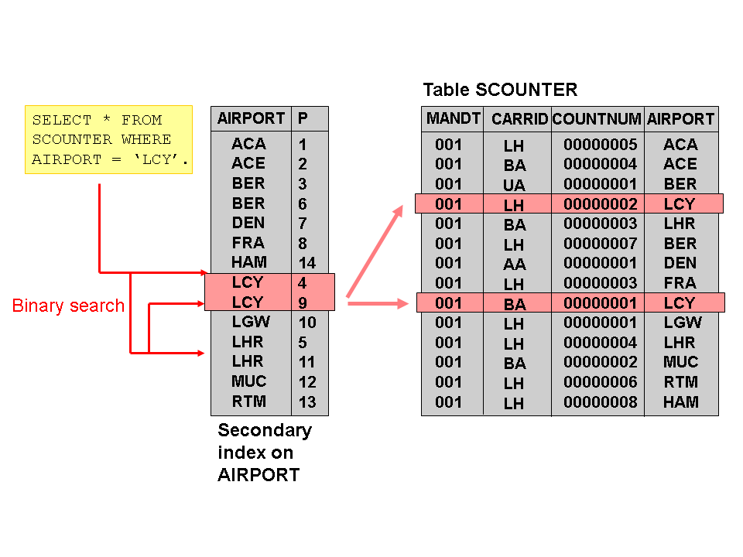
Images of Indices

Slide 33
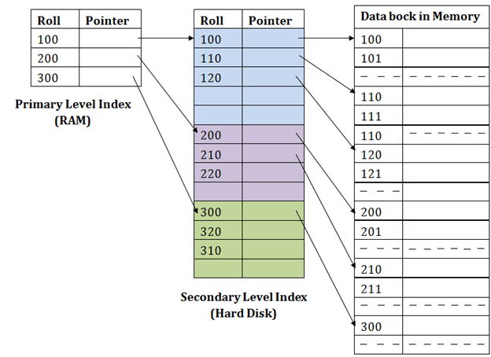
Images of Indices

Slide 34
B⁺-Tree Index Files
B⁺-tree indices are an alternative to indexed-sequential files.
Disadvantage of indexed-sequential files
performance degrades as file grows, both for index lookups and for sequential scans through the data, since many overflow blocks get created.
Periodic reorganization of entire file is required, but frequent reorganizations are undesirable
Advantage of B⁺-tree index files:
automatically reorganizes itself with small, local changes, in the face of insertions and deletions.
Reorganization of entire file is not required to maintain performance.

Slide 35
B⁺-Tree Index Files
(Minor) disadvantage of B⁺-trees:
imposes performance overhead on insertion and deletion, and adds space overhead.
The overhead is acceptable even for frequently modified files, since the cost of file reorganization is avoided.
Furthermore, since nodes may be as many as half empty (if they have the minimum number of children), there is some wasted space.
This space overhead, too, is acceptable given performance benefits of the B+-tree structure.
Advantages of B⁺-trees outweigh disadvantages
B⁺-trees are used extensively

Slide 36
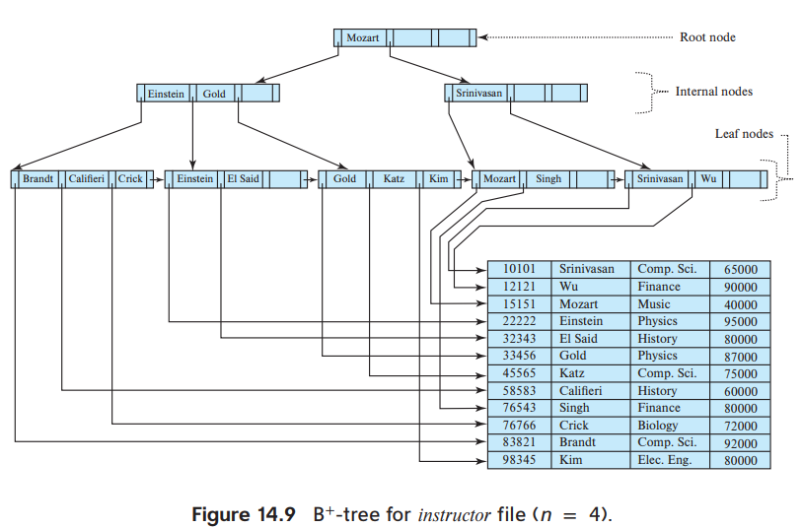
Example of B⁺-Tree

Slide 37
B⁺-Tree Index Files (Cont.)
A B⁺-tree is a rooted tree satisfying the following properties:
A B+-tree index takes the form of a balanced tree in which every path from the root to a leaf of the tree is of the same length.
Each node that is not a root or a leaf has between ⎡n/2⎤ and n children, where n (no. of Pointers) is fixed for a particular tree.
A leaf node has between ⎡(n–1)/2⎤ and n–1 values. With n = 4, B+-tree, each leaf must contain at least 2 values, and at most 3 values.
The ranges of values in each leaf do not overlap, except if there are duplicate search-key values, in which case a value may be present in more than one leaf.
Special cases:
If the root is not a leaf, it has at least 2 children.
If the root is a leaf (that is, there are no other nodes in the tree), it can have between 0 and (n–1) values.

Slide 38
B⁺-Tree Node Structure
A B+-tree index is a multilevel index, but it has a structure that differs from that of the multilevel index-sequential file.
Typical node
It contains up to n − 1 search-key values and n pointers
K_{i} are the search-key values
P_{i} are pointers to children (for non-leaf nodes) or pointers to records or buckets of records (for leaf nodes).
The search-keys in a node are ordered
K₁ < K₂ < K₃ < . . . < K_{n–1}

Slide 39
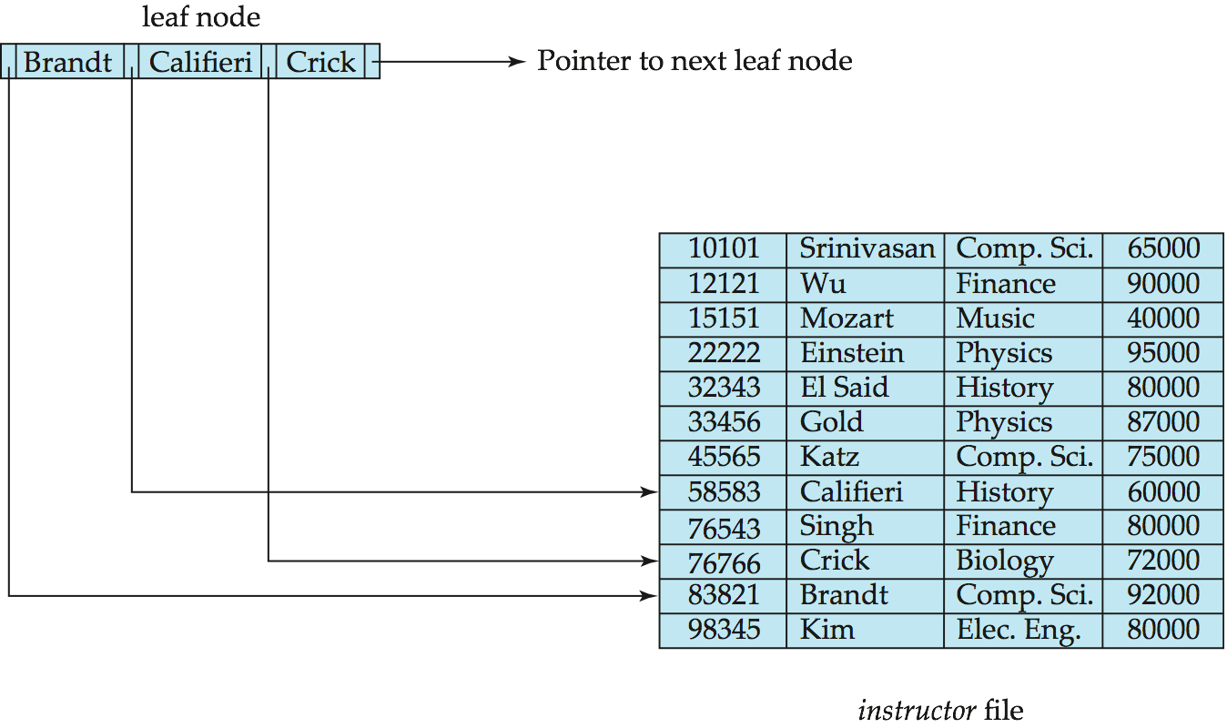
Leaf Nodes in B⁺-Trees
Properties of a leaf node:
For i = 1, 2, . . ., n–1, pointer P_{i} points to a file record with search-key value K_{i},
If L_{i}, L_{j} are leaf nodes and i < j, L_{i}’s search-key values are less than or equal to L_{j}’s search-key values
Usually used as a dense index where every search-key value must appear in some leaf node.
Since there is a linear order on the leaves based on the search-key values, P_{n} is used to chain together the leaf nodes in search-key order. This ordering allows for efficient sequential processing.

Slide 40
Non-Leaf Nodes in B⁺-Trees
Nonleaf nodes form a multi-level sparse index on the leaf nodes. Nonleaf nodes are also referred as internal nodes.
The structure is the same as that for leaf nodes, except that all pointers are pointers to tree nodes.
A non-leaf node may hold up to n pointers, and must hold at least ⎡(n/2⎤ pointers. The number of pointers in a node is called the fanout of the node
For a non-leaf node with n pointers:
All the search-keys in the subtree to which P₁ points are less than K₁
For 2 ≤ i ≤ n – 1, all the search-keys in the subtree to which P_{i} points have values greater than or equal to K_{i–1} and less than K_{i}
All the search-keys in the subtree to which P_{n} points have values greater than or equal to K_{n–1}

Slide 41
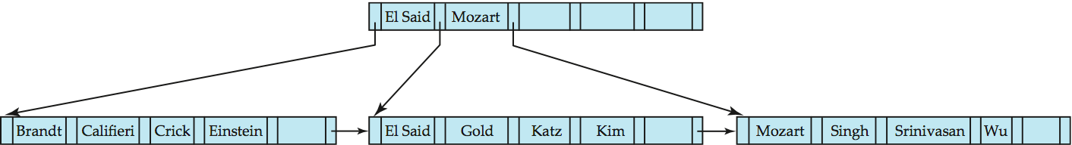
Example of B⁺-tree
B⁺-tree for instructor file (n = 6)
Leaf nodes must have between 3 and 5 values (⎡(n–1)/2⎤ and n –1, with n = 6).
Non-leaf nodes other than root must have between 3 and 6 children (⎡(n/2⎤ and n with n =6).
Root must have at least 2 children.

Slide 42
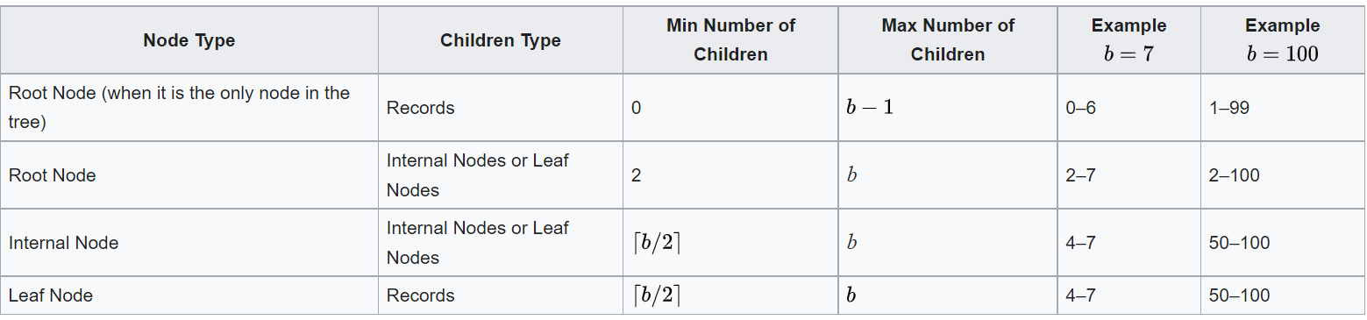
Example of B⁺-tree
b = no. of pointers

Slide 43
Observations about B⁺-trees
Since the inter-node connections are done by pointers, “logically” close blocks need not be “physically” close.
The non-leaf levels of the B⁺-tree form a hierarchy of sparse indices.
The B⁺-tree contains a relatively small number of levels
Level below root has at least 2* ⎡n/2⎤ values
Next level has at least 2* ⎡n/2⎤ * ⎡n/2⎤ values
.. etc.
If there are K search-key values in the file, the tree height is no more than ⎡ log_{⎡n/2⎤}(K)⎤
thus searches can be conducted efficiently.
Insertions and deletions to the main file can be handled efficiently, as the index can be restructured in logarithmic time (as we shall see).

Slide 44
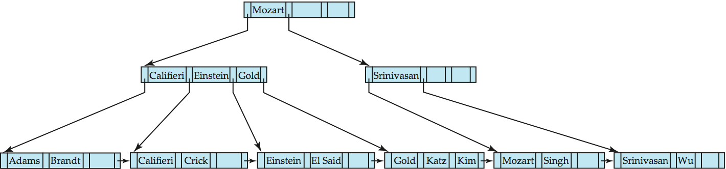
Queries on B⁺-Trees
Find record with search-key value V.
C=root
While C is not a leaf node {
Let i be least value s.t. V ≤ K_{i}.
If no such exists, set C = last non-null pointer in C
Else { if (V= K_{i} ) Set C = P_{i +1} else set C = P_{i}}
}
Let i be least value s.t. K_{i} = V
If there is such a value i, follow pointer P_{i} to the desired record.
Else no record with search-key value k exists.

Slide 45
Handling Duplicates
With duplicate search keys
In both leaf and internal nodes,
we cannot guarantee that K₁ < K₂ < K₃ < . . . < K_{n–1}
but can guarantee K₁ ≤ K₂ ≤ K₃ ≤ . . . ≤ K_{n–1}
Search-keys in the subtree to which P_{i} points
are ≤ K_{i,}, but not necessarily < K_{i,}
To see why, suppose same search key value V is present in two leaf node L_{i} and L_{i+1}. Then in parent node K_{i} must be equal to V

Slide 46
Queries on B⁺⁻Trees (Cont.)
In processing a query, we traverse a path in the tree from the root to some leaf node. If there are K search-key values in the file, the height of the tree is no more than ⎡log_{⎡n/2⎤}(K)⎤.
In practice, only a few nodes need to be accessed. A node is generally the same size as a disk block, typically 4 kilobytes.
With a search-key size of 12 bytes, and a disk-pointer size of 8 bytes, n is around 200. Even with a more conservative estimate of 32 bytes for the search-key size, n is around 100.
and n is typically around 100 (40 bytes per index entry).
With 1 million search key values and n = 100
at most log₅₀(1,000,000) = 4 nodes are accessed in a lookup.
The root node of the tree is usually heavily accessed and is likely to be in the buffer, so typically only three or fewer blocks need to be read from disk.

Slide 47
Diff. Bet B⁺⁻Tree and in-memory Tree
An important difference between B+-tree structures and in-memory tree structures, such as binary trees, is the size of a node, and as a result, the height of the tree.
In a binary tree, each node is small, and has at most two pointers. In a B+-tree, each node is large—typically a disk block—and a node can have a large number of pointers. Thus, B+-trees tend to be fat and short, unlike thin and tall binary trees.
In a balanced binary tree, the path for a lookup can be of length ⎡log₂ (K)⎤ where N is the number of records in the file being indexed.
With 1 million search key values — around 20 nodes are accessed in a lookup, if each node were on a different disk block.
The difference is significant, since each block read could require a disk arm seek, and a block read together with the disk arm seek takes about 10 milliseconds on a typical disk.

Slide 48
Updates on B⁺-Trees: Insertion
Find the leaf node in which the search-key value would appear
If the search-key value is already present in the leaf node
Add record to the file
If necessary add a pointer to the bucket.
If the search-key value is not present, then
add the record to the main file (and create a bucket if necessary)
If there is room in the leaf node, insert (key-value, pointer) pair in the leaf node
Otherwise, split the node (along with the new (key-value, pointer) entry) as discussed in the next slide.

Slide 49
Updates on B⁺-Trees: Insertion (Cont.)
Splitting a leaf node:
take the n (search-key value, pointer) pairs (including the one being inserted) in sorted order. Place the first ⎡n/2⎤ in the original node, and the rest in a new node.
let the new node be p, and let k be the least key value in p. Insert (k,p) in the parent of the node being split.
If the parent is full, split it and propagate the split further up.
Splitting of nodes proceeds upwards till a node that is not full is found.
In the worst case the root node may be split increasing the height of the tree by 1.
Result of splitting node containing Brandt, Califieri and Crick on inserting Adams
Next step: insert entry with (Califieri,pointer-to-new-node) into parent

Slide 50
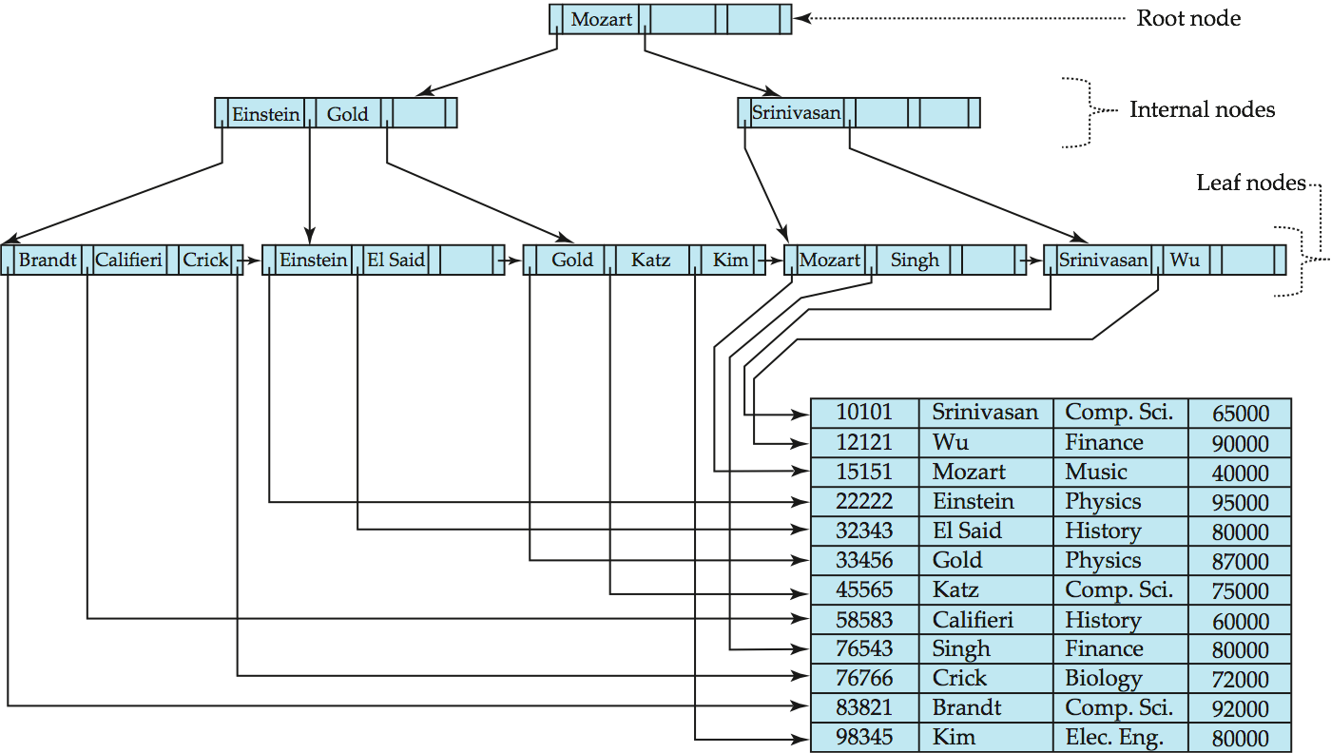
B⁺-Tree Insertion
B⁺-Tree before and after insertion of “Adams”

Slide 51
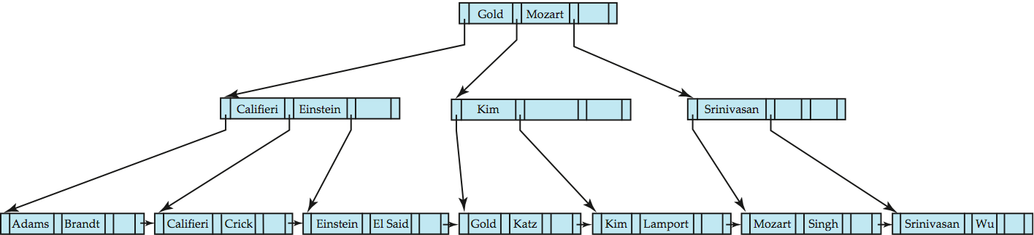
B⁺-Tree Insertion
B⁺-Tree before and after insertion of “Lamport”

Slide 52
Insertion in B⁺-Trees (Cont.)
Splitting a non-leaf node: when inserting (k,p) into an already full internal node N
Copy N to an in-memory area M with space for n+1 pointers and n keys
Insert (k,p) into M
Copy P₁,K₁, …, K _{⎡n/2⎤-1},P _{⎡n/2⎤} from M back into node N
Copy P_{⎡n/2⎤+1},K _{⎡n/2⎤+1},…,K_{n},P_{n+1} from M into newly allocated node N’
Insert (K _{⎡n/2⎤},N’) into parent N
Read pseudocode in book!
Califieri
Adams Brandt Califieri Crick
Adams Brandt
Crick

Slide 53
Updates on B⁺-Trees: Deletion
Find the record to be deleted, and remove it from the main file and from the bucket (if present)
Remove (search-key value, pointer) from the leaf node if there is no bucket or if the bucket has become empty
If the node has too few entries due to the removal, and the entries in the node and a sibling fit into a single node, then merge siblings:
Insert all the search-key values in the two nodes into a single node (the one on the left), and delete the other node.
Delete the pair (K_{i–1}, P_{i}), where P_{i} is the pointer to the deleted node, from its parent, recursively using the above procedure.

Slide 54
Updates on B⁺-Trees: Deletion
Otherwise, if the node has too few entries due to the removal, but the entries in the node and a sibling do not fit into a single node, then redistribute pointers:
Redistribute the pointers between the node and a sibling such that both have more than the minimum number of entries.
Update the corresponding search-key value in the parent of the node.
The node deletions may cascade upwards till a node which has ⎡n/2⎤ or more pointers is found.
If the root node has only one pointer after deletion, it is deleted and the sole child becomes the root.

Slide 55
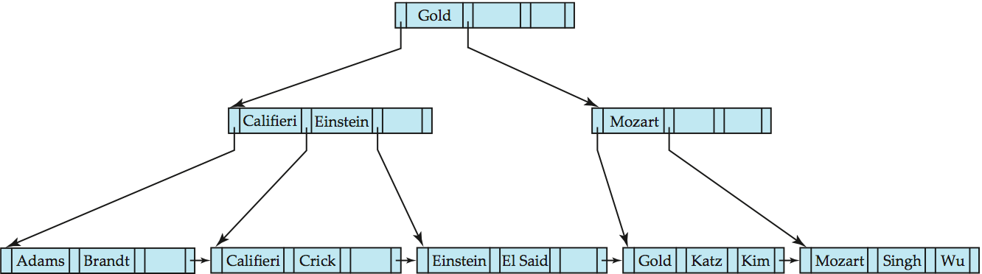
Examples of B⁺-Tree Deletion
Before and after deleting “Srinivasan”
Deleting “Srinivasan” causes merging of under-full leaves

Slide 56
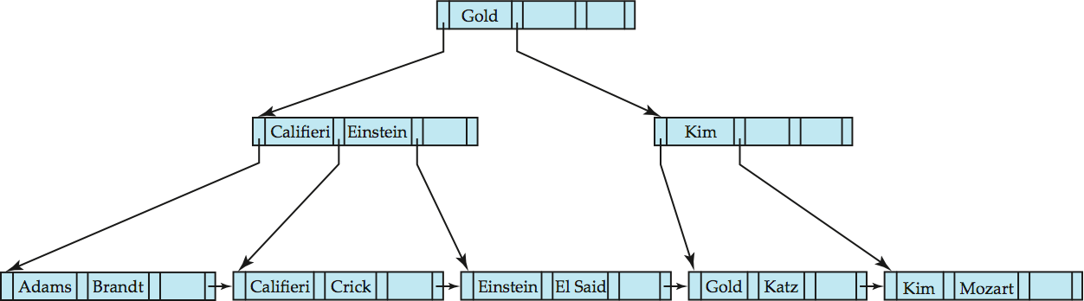
Examples of B⁺-tree Deletion (Cont.)
Deletion of “Singh” and “Wu” from result of previous example
Leaf containing Singh and Wu became underfull, and borrowed a value Kim from its left sibling
Search-key value in the parent changes as a result
B+ Tree simulator:
https://www.cs.usfca.edu/~galles/visualization/BPlusTree.html
https://dichchankinh.com/~galles/visualization/BPlusTree.html
https://goneill.co.nz/btree-demo.php

Slide 57
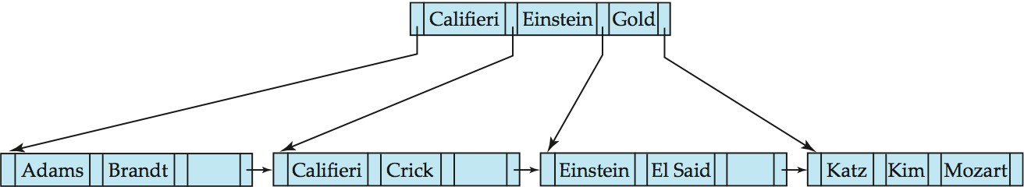
Example of B⁺-tree Deletion (Cont.)
Before and after deletion of “Gold” from earlier example
Node with Gold and Katz became underfull, and was merged with its sibling
Parent node becomes underfull, and is merged with its sibling
Value separating two nodes (at the parent) is pulled down when merging
Root node then has only one child, and is deleted

Slide 58
Non-Unique Search Keys
If a relation can have more than one record containing the same search key value, it is said to be a nonunique search key.
One problem is in the efficiency of record deletion.
Suppose a particular search-key value occurs a large number of times, and one of the records with that search key is to be deleted. The deletion may have to search through a number of entries, potentially across multiple leaf nodes, to find the entry corresponding to the particular record being deleted.
A simple solution, used by most database systems, is to make search keys unique by creating a composite search key containing the original search key and another attribute, which together are unique across all records.
The extra attribute can be a record-id, which is a pointer to the record, or any other attribute (primary key) whose value is unique among all records with the same search key value. The extra attribute is called a uniquifier attribute.
Notes:
58

Slide 59
Non-Unique Search Keys
When a record is to be deleted, the composite search-key value is computed from the record, and then used to look up the index. Since the value is unique, the corresponding leaf level entry can be found with a single traversal from root to leaf, with no further accesses at the leaf level. As a result, record deletion can be done efficiently.
A search with the original search-key attribute simply ignores the value of the uniquifier attribute when comparing search-key values.
Alternatives to scheme is to store each key value only once in the tree, and to keep a bucket (or list) of record pointers with a search-key value, to handle nonunique search keys.
Advantage: This approach is more space efficient since it stores the key value only once; however, it creates several complications when B+-trees are implemented.
Notes:
59

Slide 60
Non-Unique Search Keys
Disadvantages:
If the buckets are kept in the leaf node, extra code is needed to deal with variable-size buckets, and to deal with buckets that grow larger than the size of the leaf node.
If the buckets are stored in separate blocks, an extra I/O operation may be required to fetch records.
In addition to these problems, the bucket approach also has the problem of inefficiency for record deletion if a search-key value occurs a large number of times.
Due to the inefficiency of deletion, as well as other complications due to duplicate search keys, B+-tree implementations in most database systems only handle unique search keys, and they automatically add record-ids or other attributes to make nonunique search keys unique.
Notes:
60

Slide 61
B⁺-Tree File Organization
The main drawback of index-sequential file organization is the degradation of performance as the file grows: With growth, an increasing percentage of index entries and actual records become out of order and are stored in overflow blocks.
Degradation of index lookup problem is solved by using B⁺-Tree indices on the file.
The B+-tree structure is used not only as an index, but also as an organizer for records in a file.
The leaf nodes in a B⁺-tree file organization store records, instead of pointers. Since records are larger than pointers, the maximum number of records that can be stored in a leaf node is less than the number of pointers in a nonleaf node.
However, leaf nodes are still required to be at least half full
Insertion and deletion are handled in the same way as insertion and deletion of entries in a B⁺-tree index.

Slide 62
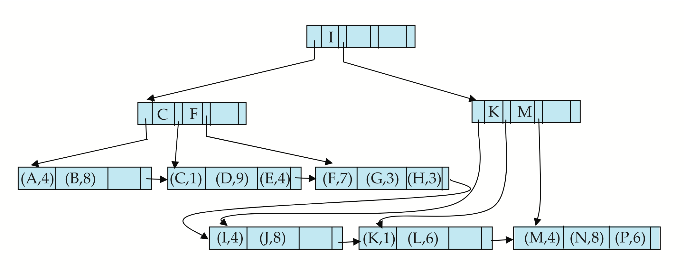
B⁺-Tree File Organization (Cont.)
Example of B⁺-tree File Organization
In B+-tree for file organization, good space utilization is important since records use more space than key and pointers.
To improve space utilization, involve more sibling nodes in redistribution during splits and merges for both leaf nodes and nonleaf nodes
Involving 2 siblings in redistribution (to avoid split / merge where possible) results in each node having at least entries

Slide 63
B⁺-Tree File Organization
During insertion: if a node is full the system attempts to redistribute some of its entries to one of the adjacent nodes, to make space for a new entry.
If the adjacent nodes are themselves full, the system splits the node, and splits the entries evenly among one of the adjacent nodes and the two nodes that it obtained by splitting the original node.
Since the three nodes together contain one more record than can fit in two nodes, each node will be about two-thirds full.
More precisely, each node will have at least entries, where n is the maximum number of entries that the node can hold.
During deletion of a record, if the occupancy of a node falls below , the system attempts to borrow an entry from one of the sibling nodes.
If both sibling nodes have records, instead of borrowing an entry, the system redistributes the entries in the node and in the two siblings evenly between two of the nodes, and deletes the third node, because the total number of entries is , which is less than 2n.
However, the cost of update becomes higher as more sibling nodes are involved in the redistribution.

Slide 64
Secondary Indices and Record Reallocation
In B+-tree file organization, may change the location of records even when the records have not been updated. As an example, when a leaf node is split , a number of records are moved to a new node.
In such cases, all secondary indices that store pointers to the relocated records would have to be updated (even key-values have not changed)
Each leaf node may contain a fairly large number of records, and each of them may be in different locations on each secondary index.
Thus a leaf-node split may require tens or even hundreds of I/O operations to update all affected secondary indices, making it a very expensive operation.
Solution: use primary-index search key instead of record pointer in secondary index
Extra traversal :use the secondary index to find the primary-index search-key values, and then the primary index to find the corresponding records.
Higher cost for queries, but node splits are cheap
Add record-id if primary-index search key is non-unique
Notes:
64

Slide 65
Indexing Strings
Creating B+-tree indices on string-valued attributes raises 2 problems:
1. strings can be of variable length
2. strings can be long, leading to a low fanout and a correspondingly increased tree height.
Thus space utilization as criterion for splitting, not number of pointers
The fanout of nodes can be increased by using a technique called prefix compression.
Key values at internal nodes can be prefixes of full key
Keep enough characters to distinguish entries in the subtrees separated by the key value
E.g. “Silas” and “Silberschatz” can be separated by “Silb”
Keys in leaf node can be compressed by sharing common prefixes

Slide 66
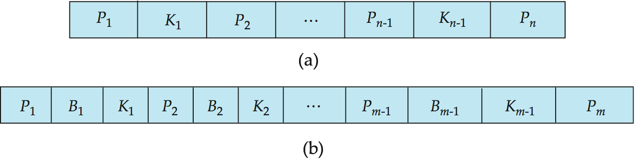
B-Tree Index Files
Similar to B+-tree, but B-tree allows search-key values to appear only once; eliminates redundant storage of search keys.
Search keys in nonleaf nodes appear nowhere else in the B-tree; an additional pointer field for each search key in a nonleaf node must be included.
Generalized B-tree leaf node
Nonleaf node – pointers B_{i} are the bucket or file record pointers.

Slide 67
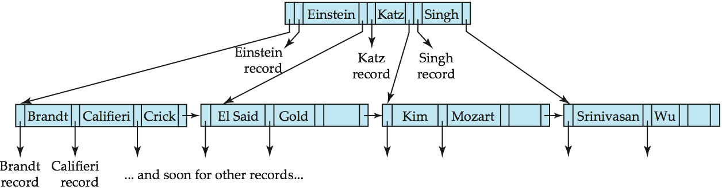
B-Tree Index File Example
B-tree (above) and B+-tree (below) on same data

Slide 68
B-Tree Index Files (Cont.)
Advantages of B-Tree indices:
May use less tree nodes than a corresponding B⁺-Tree.
Sometimes possible to find search-key value before reaching leaf node.
Disadvantages of B-Tree indices:
Only small fraction of all search-key values are found early
Non-leaf nodes are larger, so fan-out is reduced. Thus, B-Trees typically have greater depth than corresponding B⁺-Tree
Insertion and deletion more complicated than in B⁺-Trees
Implementation is harder than B⁺-Trees.
Typically, advantages of B-Trees do not out weigh disadvantages.

Slide 69
B+ Tree vs. B Tree
B + Tree | B Tree
Search keys can be repeated. | Search keys cannot be redundant.
Data is only saved on the leaf nodes. | Both leaf nodes and internal nodes can store data
Data stored on the leaf node makes the search more accurate and faster. | Searching is slow due to data stored on Leaf and internal nodes.
Deletion is not difficult as an element is only removed from a leaf node. | Deletion of elements is a complicated and time-consuming process.
Linked leaf nodes make the search efficient and quick. | You cannot link leaf nodes.

Slide 70
Hashing

Slide 71
Classification of Hashing
Hashing
Static
Closed
Open
Dynamic
Extendable
Linear

Slide 72
Static Hashing
One disadvantage of sequential file organization is that we must access an index structure to locate data, or must use binary search, and that results in more I/O operations.
File organizations based on the technique of hashing allow us to avoid accessing an index structure. Hashing also provides a way of constructing indices.
A bucket is a unit of storage containing one or more records. A bucket is typically a disk block but could be chosen to be smaller or larger than a disk block.
In a hash file organization we obtain the bucket of a record directly from its search-key value using a hash function.
Hash function h is a function from the set of all search-key values K to the set of all bucket addresses B.

Slide 73
Static Hashing
Hash function is used to locate records for access, insertion as well as deletion.
To insert a record with search key K_{i}, we compute h(K_{i} ), which gives the address of the bucket for that record. Assuming there is space in the bucket, the record is stored in that bucket.
To perform a lookup on a search-key value K_{i} , we simply compute h(K_{i} ), then search the bucket with that address.
Records with different search-key values may be mapped to the same bucket; thus entire bucket has to be searched sequentially to locate a record.
Suppose that two search keys, K₅ and K₇, have the same hash value; that is, h(K₅) = h(K₇). If we perform a lookup on K₅, the bucket h(K₅) contains records with search-key values K₅ and records with search-key values K₇. Thus, we have to check the search-key value of every record in the bucket to verify that the record is one that we want.

Slide 74
Static Hashing
Deletion is equally straightforward. If the search-key value of the record to be deleted is K_{i}, we compute h(K_{i} ), then search the corresponding bucket for that record, and delete the record from the bucket.
Hashing can be used for two different purposes. In a hash file organization, we obtain the address of the disk block containing a desired record directly by computing a function on the search-key value of the record.
In a hash index organization we organize the search keys, with their associated pointers, into a hash file structure.

Slide 75
Example of Hash File Organization
Hash file organization of instructor file, using dept_name as key (See figure in next slide.)
There are 8 buckets,
The representation of the ith character is assumed to be the integer i.
The hash function returns the sum of the representations of the characters modulo 8
E.g. h(Music) = 1 h(History) = 2 h(Physics) = 3 h(Elec. Eng.) = 3

Slide 76

Example of Hash File Organization
Hash file organization of instructor file, using dept_name as key (see previous slide for details).

Slide 77
Hash Function
The worst possible hash function maps all search-key values to the same bucket. Such a function is undesirable because all the records have to be kept in the same bucket. A lookup has to examine every such record to find the one desired.
An ideal hash function distributes the stored keys uniformly across all the buckets, so that every bucket has the same number of records.
Since we do not know at design time precisely which search-key values will be stored in the file, we want to choose a hash function that assigns search-key values to buckets in such a way that the distribution has these two qualities:
Uniform: The distribution is uniform. That is, the hash function assigns each bucket the same number of search-key values from the set of all possible search-key values.

Slide 78
Hash Function
Random: The distribution is random. That is, in the average case, each bucket will have nearly the same number of values assigned to it, regardless of the actual distribution of search-key values.
More precisely, the hash value will not be correlated to any externally visible ordering on the search-key values, such as alphabetic ordering or ordering by the length of the search keys; the hash function will appear to be random.
Illustration: (form book)
Example 1: Simple hash function, but fails to provide a uniform distribution.
Example 2: The distribution of search-key values may be uniform, but is not random.

Slide 79
Hash Functions
The distribution of records is not uniform—some buckets receive more records than others do. If the function has a random dis-tribution, even if there are correlations in the search keys, the randomness of the distribution will make it very likely that all buckets will have roughly the same number of records, as long as each search key occurs in only a small fraction of the records.
If a single search key occurs in a large fraction of the records, the bucket containing it is likely to have more records than other buckets, regardless of the hash function used.
Typical hash functions perform computation on the internal binary representation of characters in the search-key.
For example, for a string search-key, the binary representa-tions of all the characters in the string could be added and the sum modulo the number of buckets could be returned.

Slide 80
Hash Functions
Hash functions require careful design.
A bad hash function may result in lookup taking time proportional to the number of search keys in the file.
A well designed function gives an average-case lookup time that is a (small) constant, independent of the number of search keys in the file.

Slide 81
Handling of Bucket Overflows
Suppose, when a record is inserted, the bucket to which it is mapped has space to store the record. If the bucket does not have enough space, a bucket overflow is said to occur.
Bucket overflow can occur for several reasons:
Insufficient buckets : The number of buckets, n_{B}, must be chosen such that n_{B} > n_{r} / f_{r}, where
n_{r} denotes the total number of records that will be stored and
f_{r} denotes the number of records that will fit in a bucket.
This designation, of course, assumes that the total number of records is known when the hash function is chosen.
Skew in distribution of records: Some buckets are assigned more records than are others, so a bucket may overflow even when other buckets still have space. This situation is called bucket skew. Skew can occur for two reasons:
Multiple records have same search-key value
Chosen hash function produces non-uniform distribution of key values

Slide 82
Handling of Bucket Overflows
So that the probability of bucket overflow is reduced, the number of buckets is chosen to be (n_{r} / f_{r} ) ∗ (1 + d), where d is a fudge factor, typically around 0.2.
Some space is wasted: About 20 percent of the space in the buckets will be empty. But the benefit is that the probability of overflow is reduced.
Despite allocation of a few more buckets than required, bucket overflow can still occur.
We handle bucket overflow by using overflow buckets. If a record must be inserted into a bucket b, and b is already full, the system provides an overflow bucket for b, and inserts the record into the overflow bucket. If the overflow bucket is also full, the system provides another overflow bucket, and so on.
All the overflow buckets of a given bucket are chained together in a linked list. Overflow handling using such a linked list is called overflow chaining.

Slide 83
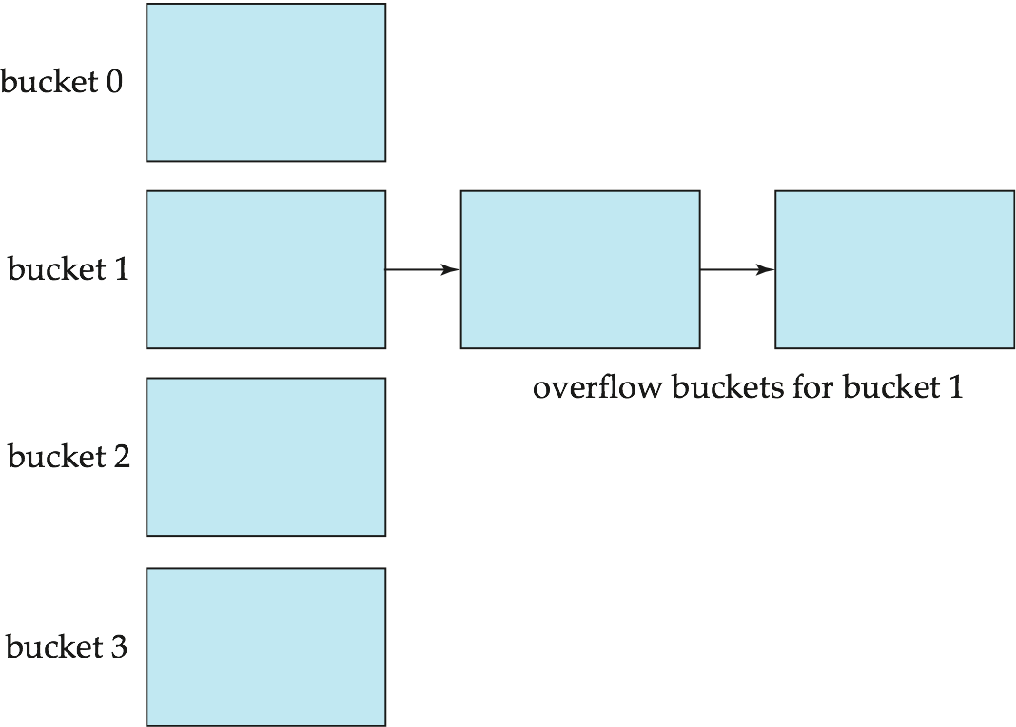
Handling of Bucket Overflows (Cont.)
.

Slide 84
Closed and Open Hashing
The form of hash structure of above form sometimes referred to as closed hashing (more commonly closed addressing).
Under an alternative approach, called open hashing (more commonly open addressing), the set of buckets is fixed, and there are no overflow chains. Instead, if a bucket is full, the system inserts records in some other bucket in the initial set of buckets B.
One policy is to use the next bucket (in cyclic order) that has space; this policy is called linear probing. Other policies, such as computing further hash functions, are also used.
Open hashing has been used to construct symbol tables for compilers and assemblers, but closed hashing is preferable for database systems.
The reason is that deletion under open hashing is troublesome. Usually, compilers and assemblers perform only lookup and insertion operations on their symbol tables.
However, in a database system, it is important to be able to handle deletion as well as insertion. Thus, open hashing is of only minor importance in database implementation.

Slide 85
Hash Indices
Hashing can be used not only for file organization, but also for index-structure creation.
A hash index organizes the search keys, with their associated record pointers, into a hash file structure.
Apply a hash function on a search key to identify a bucket, and store the key and its associated pointers in the bucket (or in overflow buckets).
We use the term hash index to denote hash file structures as well as secondary hash indices.
Strictly speaking, hash indices are always secondary indices
if the file itself is organized using hashing, a separate primary hash index on it using the same search-key is unnecessary.
However, since hash file organization provides the same direct access to records that indexing provides, we pretend that a file organized by hashing also has a clustering hash index on it.

Slide 86
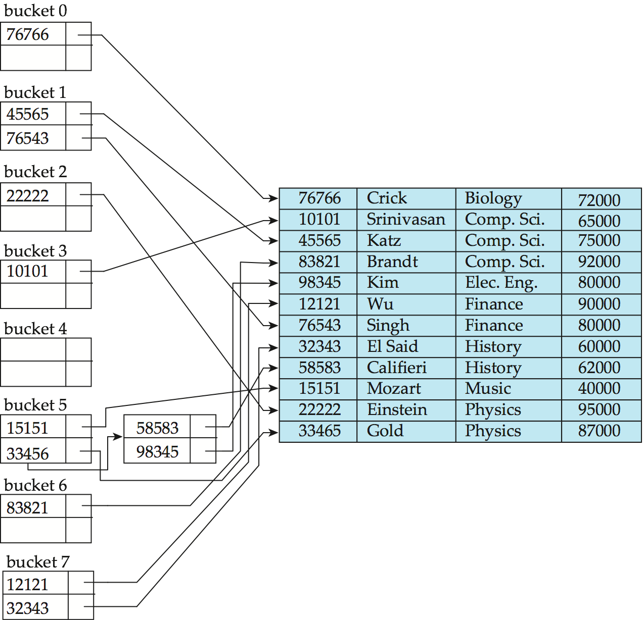
Example of Hash Index
hash index on instructor, on attribute ID

Slide 87
Deficiencies of Static Hashing
In static hashing, function h maps search-key values to a fixed set of B of bucket addresses. Databases grow or shrink with time.
If initial number of buckets is too small, and file grows, performance will degrade due to too much overflows.
If space is allocated for anticipated growth, a significant amount of space will be wasted initially (and buckets will be underfull).
If database shrinks, again space will be wasted.
One solution: periodic re-organization of the file with a new hash function
This reorganization is a massive, time-consuming operation. Furthermore, it is necessary to forbid access to the file during reorganization.
Better solution: allow the number of buckets to be modified dynamically to accommodate the growth or shrinkage of the database.

Slide 88
Dynamic Hashing
Good for database that grows and shrinks in size
Allows the hash function to be modified dynamically
Extendable hashing – one form of dynamic hashing
Hash function generates values over a large range — typically b-bit binary integers, with b = 32.
At any time use only a prefix of the hash function to index into a table of bucket addresses.
Let the length of the prefix be i bits, 0 ≤ i ≤ 32.
Bucket address table size = 2^{i.} Initially i = 0
Value of i grows and shrinks as the size of the database grows and shrinks.
Multiple entries in the bucket address table may point to a bucket (why?)
Thus, actual number of buckets is < 2^{i}
The number of buckets also changes dynamically due to coalescing and splitting of buckets.

Slide 89
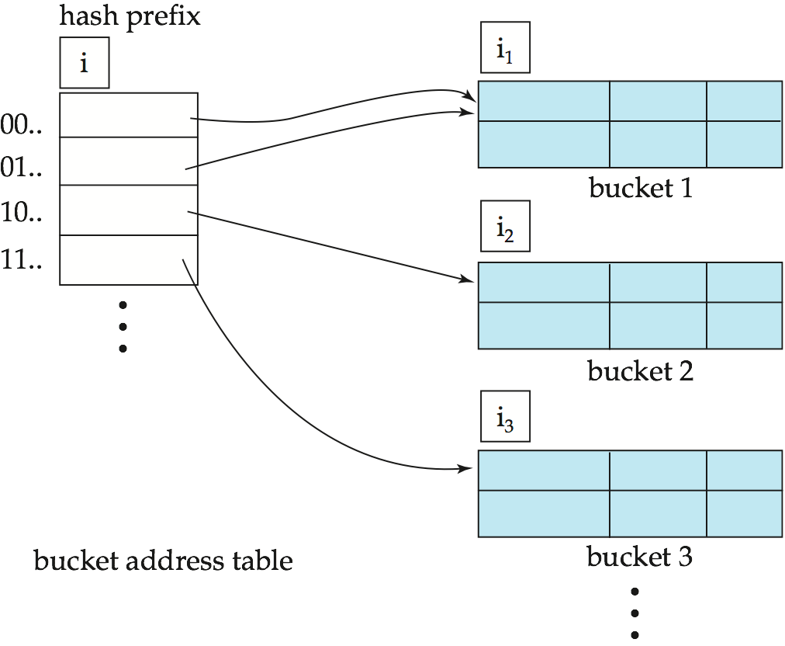
General Extendable Hash Structure
In this structure, i₂ = i₃ = i, whereas i₁ = i – 1 (see next slide for details)

Slide 90
Use of Extendable Hash Structure
Each bucket j stores a value i_{j}
All the entries that point to the same bucket have the same values on the first i_{j} bits.
To locate the bucket containing search-key K_{j}:
1. Compute h(K_{j}) = X
2. Use the first i high order bits of X as a displacement into bucket address table, and follow the pointer to appropriate bucket
To insert a record with search-key value K_{j}
follow same procedure as look-up and locate the bucket, say j.
If there is room in the bucket j insert record in the bucket.
Else the bucket must be split and insertion re-attempted (next slide.)
Overflow buckets used instead in some cases (will see shortly)

Slide 91
Insertion in Extendable Hash Structure (Cont)
To split a bucket j when inserting record with search-key value K_{j}:
If i > i_{j} (more than one pointer to bucket j)
allocate a new bucket z, and set i_{j} = i_{z} = (i_{j} + 1)
Update the second half of the bucket address table entries originally pointing to j, to point to z
remove each record in bucket j and reinsert (in j or z)
recompute new bucket for K_{j} and insert record in the bucket (further splitting is required if the bucket is still full)
If i = i_{j} (only one pointer to bucket j)
If i reaches some limit b, or too many splits have happened in this insertion, create an overflow bucket
Else
increment i and double the size of the bucket address table.
replace each entry in the table by two entries that point to the same bucket.
recompute new bucket address table entry for K_{j} Now i > i_{j} so use the first case above.

Slide 92
Deletion in Extendable Hash Structure
To delete a key value,
locate it in its bucket and remove it.
The bucket itself can be removed if it becomes empty (with appropriate updates to the bucket address table).
Coalescing of buckets can be done (can coalesce only with a “buddy” bucket having same value of i_{j} and same i_{j} –1 prefix, if it is present)
Decreasing bucket address table size is also possible
Note: decreasing bucket address table size is an expensive operation and should be done only if number of buckets becomes much smaller than the size of the table

Slide 93
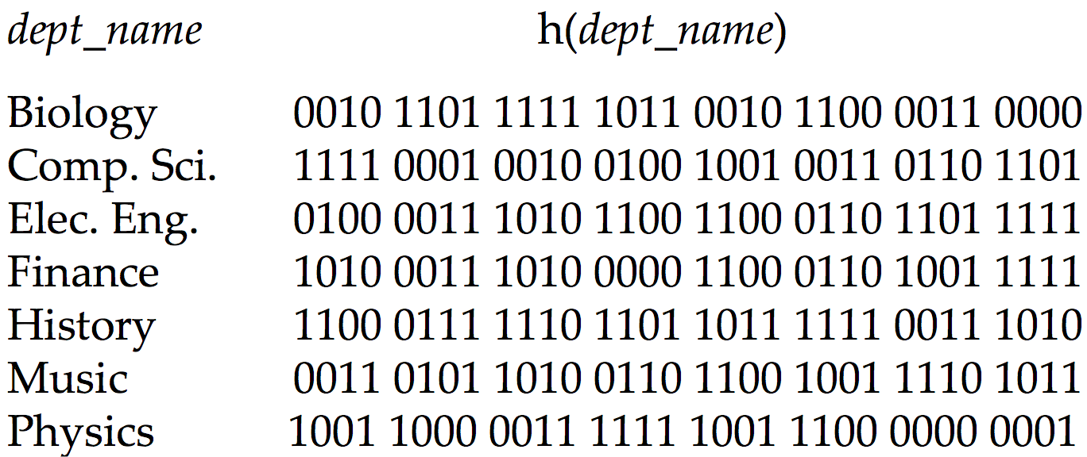
Use of Extendable Hash Structure: Example

Slide 94
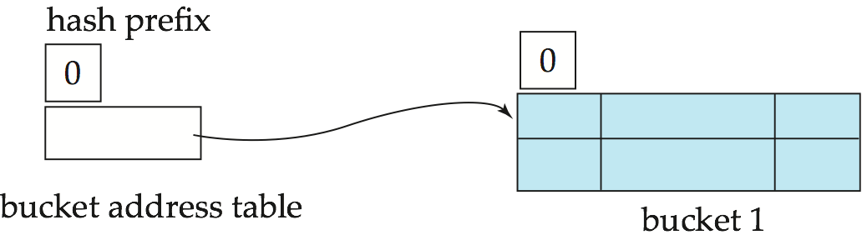
Example (Cont.)
Initial Hash structure; bucket size = 2

Slide 95
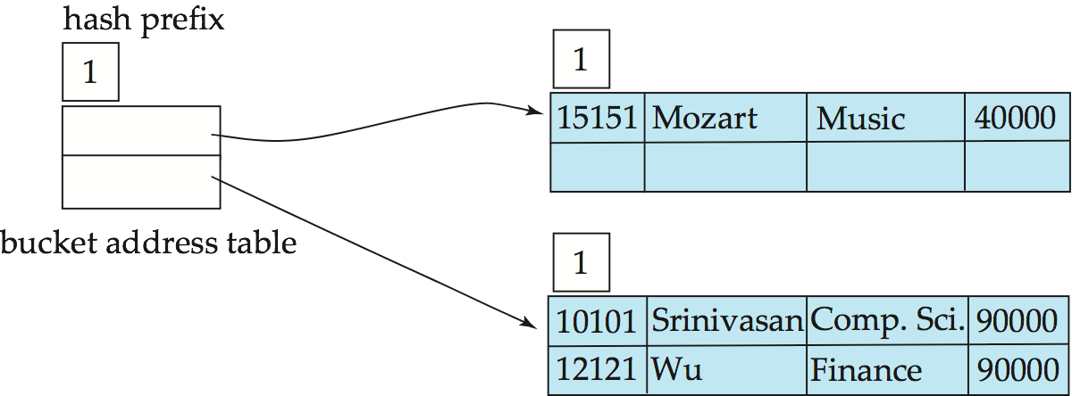
Example (Cont.)
Hash structure after insertion of “Mozart”, “Srinivasan”, and “Wu” records
0
1

Slide 96
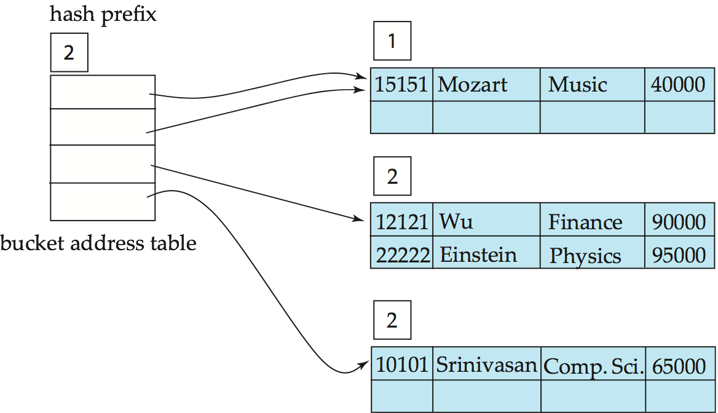
Example (Cont.)
Hash structure after insertion of Einstein record
0 | 0
0 | 1
1 | 0
1 | 1

Slide 97
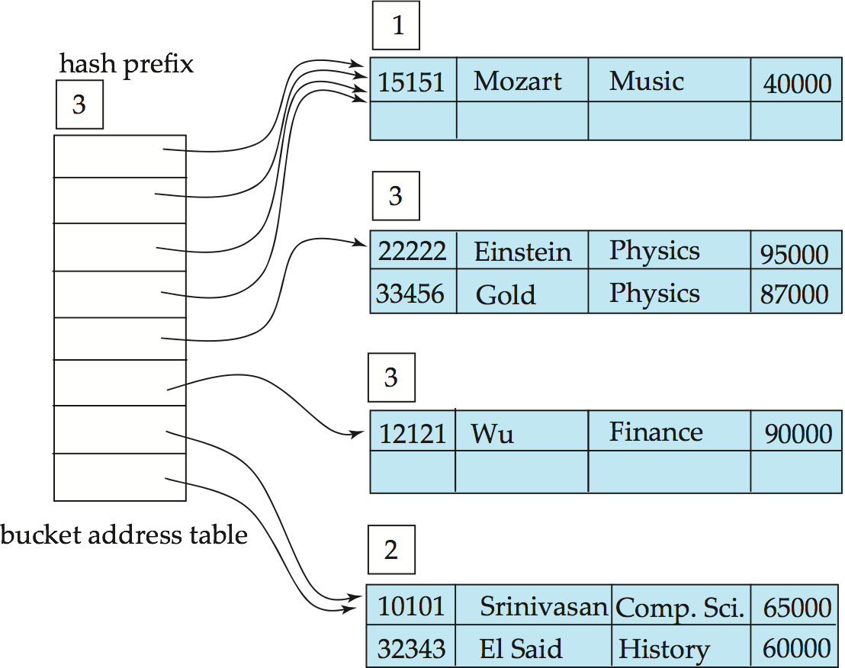
Example (Cont.)
Hash structure after insertion of Gold and El Said records
0 | 0 | 0
0 | 0 | 1
0 | 1 | 0
0 | 1 | 1
1 | 0 | 0
1 | 0 | 1
1 | 1 | 0
1 | 1 | 1

Slide 98
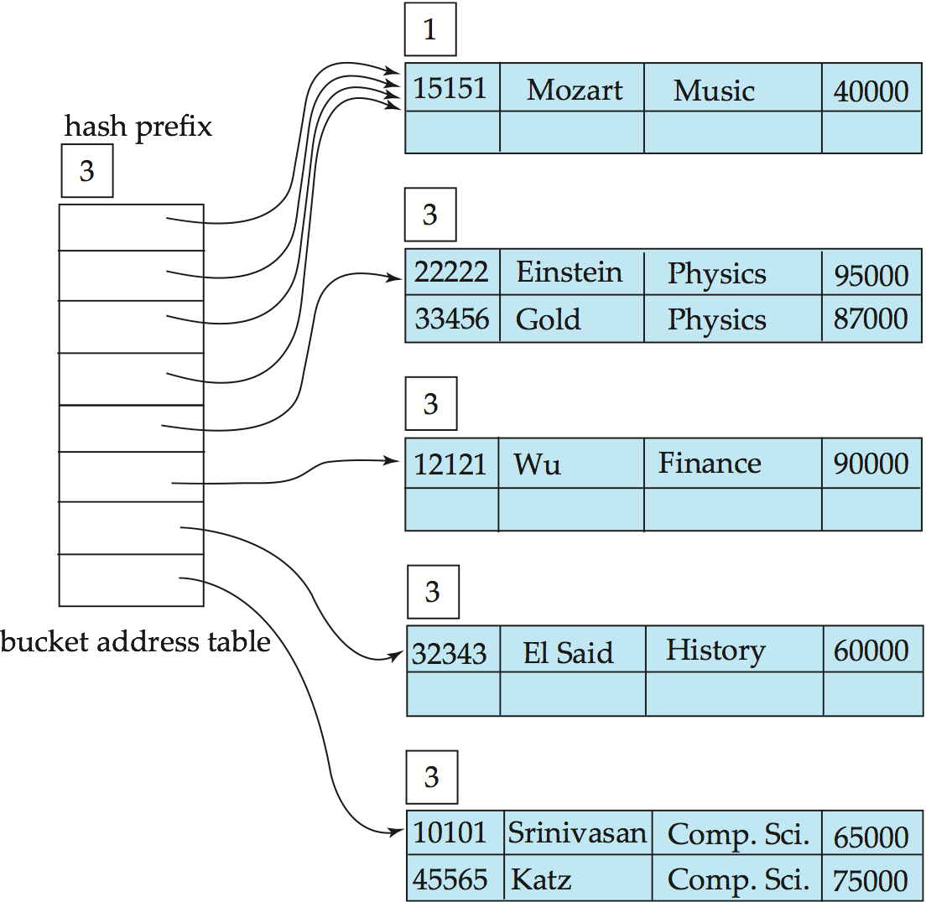
Example (Cont.)
Hash structure after insertion of Katz record
0 | 0 | 0
0 | 0 | 1
0 | 1 | 0
0 | 1 | 1
1 | 0 | 0
1 | 0 | 1
1 | 1 | 0
1 | 1 | 1

Slide 99
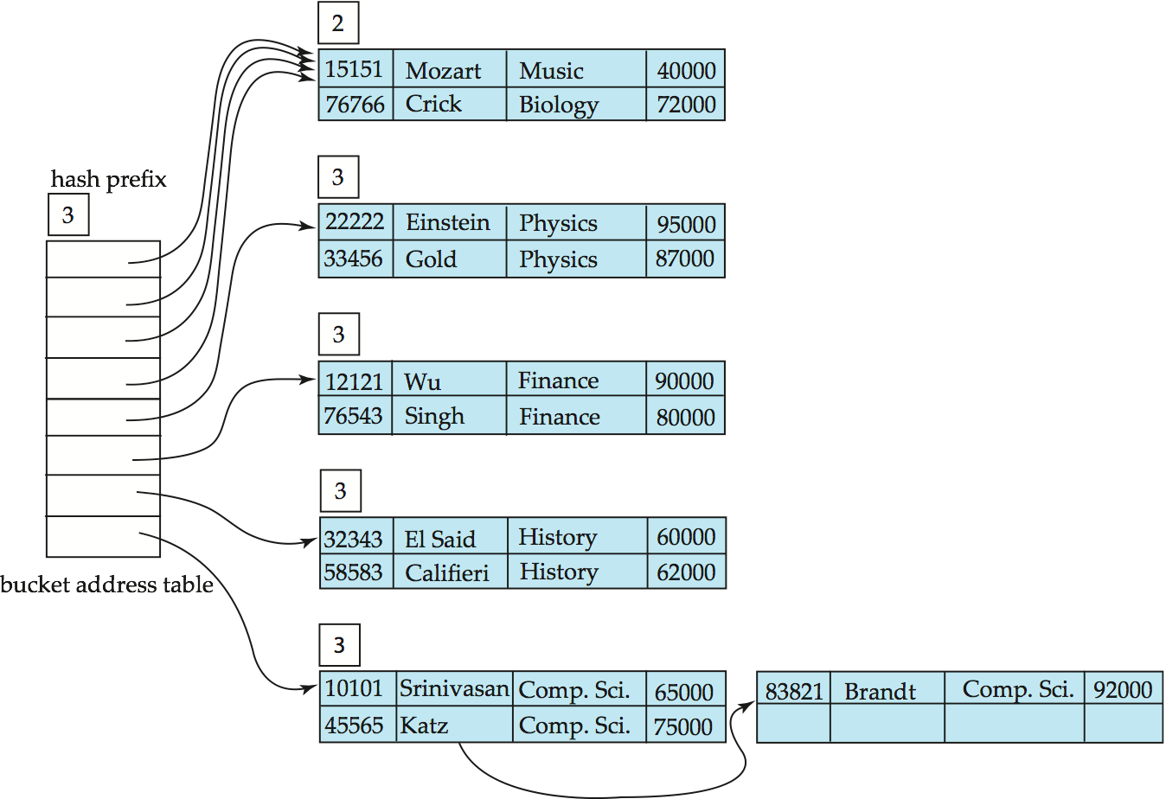
Example (Cont.)
And after insertion of
eleven records
0 | 0 | 0
0 | 0 | 1
0 | 1 | 0
0 | 1 | 1
1 | 0 | 0
1 | 0 | 1
1 | 1 | 0
1 | 1 | 1

Slide 100
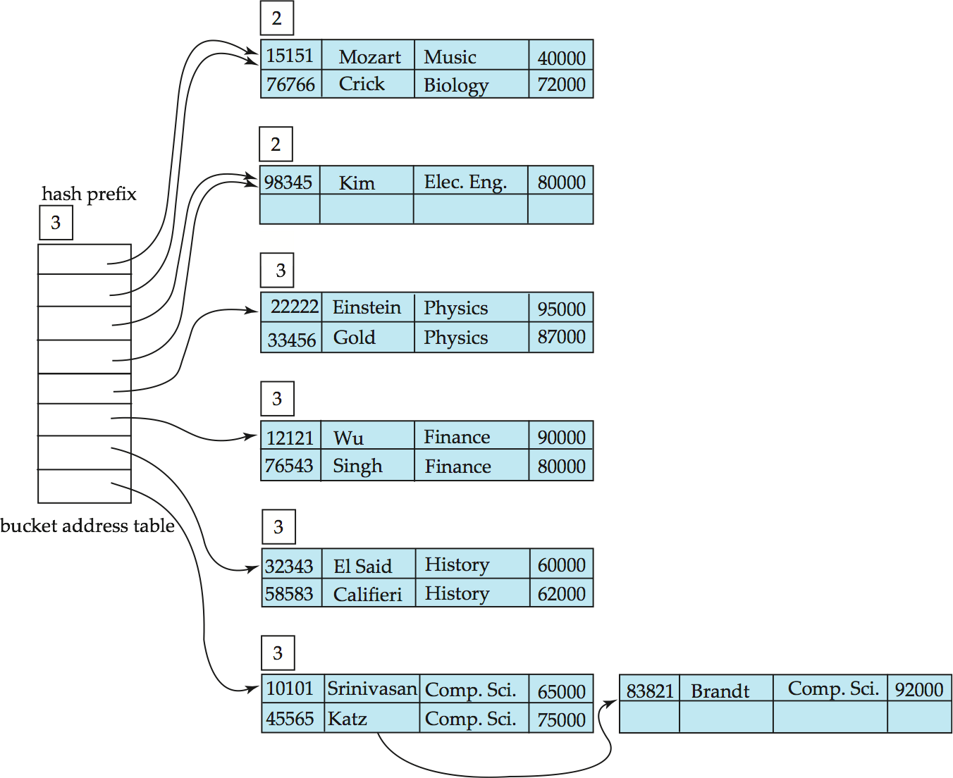
Example (Cont.)
And after insertion of
Kim record in previous
hash structure
0 | 0 | 0
0 | 0 | 1
0 | 1 | 0
0 | 1 | 1
1 | 0 | 0
1 | 0 | 1
1 | 1 | 0
1 | 1 | 1

Slide 101
Static Hashing vs. Dynamic Hashing
Benefits of extendable hashing over static hashing:
Hash performance does not degrade with growth of file
Minimal space overhead
Although the bucket address table incurs additional overhead, it contains one pointer for each hash value for the current prefix length. This table is thus small.
The main space saving of extendable hashing over other forms of hashing is that no buckets need to be reserved for future growth; rather, buckets can be allocated dynamically.
Disadvantages of extendable hashing
Extra level of indirection to find desired record, since the system must access the bucket address table before accessing the bucket itself (minor effect on performance)

Slide 102
Static Hashing vs. Dynamic Hashing
Bucket address table may itself become very big (larger than memory)
Cannot allocate very large contiguous areas on disk either
Solution: B⁺-tree structure to locate desired record in bucket address table
Changing size of bucket address table is an expensive operation
Thus, extendable hashing appears to be a highly attractive technique, provided the added complexity involved in its implemen-tation is accepted.
Linear hashing is an alternative mechanism
Allows incremental growth of its directory (equivalent to bucket address table)
At the cost of more bucket overflows

Slide 103
Comparison of Ordered Indexing and Hashing
Files of records can be organized as
ordered files by using index-sequential organization or
B+-tree organizations or
by using hashing or
as heap files, where the records are not ordered in any particular way.
Each scheme has advantages in certain situations. Most database systems support B+-trees and may additionally support some form of hash file organization or hash indices.
To make a choice of file organization and indexing techniques for a relation, the implementer or the database designer must consider the following issues:
Is the cost of periodic reorganization of the index or hash organization acceptable?

Slide 104
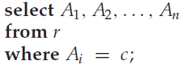
Comparison of Ordered Indexing and Hashing
What is the relative frequency of insertion and deletion?
Is it desirable to optimize average access time at the expense of increasing the worst-case access time?
What types of queries are users likely to pose?
The fourth issue, the expected type of query, is critical to the choice of ordered indexing or hashing.
If most queries are point queries:
Hashing scheme is preferable here.
An ordered-index lookup requires time proportional to the log of the number of values in r for A_{i} .
In a hash structure, however, the average lookup time is a constant independent of the size of the database.

Slide 105
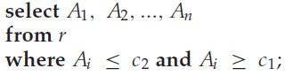
Comparison of Ordered Indexing and Hashing
In indexing, the worst-case lookup time is proportional to the log of the number of values in r for A_{i} .
By contrast, for hashing, the worst-case lookup time is proportional to the number of values in r for A_{i} .
Choice: the worst-case lookup time is unlikely to occur with hashing, and hashing is preferable in this case.
If most queries are range queries:
Ordered-index techniques are preferable to hashing.
Using index stucture, perform a lookup on value c₁. Once the bucket is found for value c₁, follow the pointer chain in the index to read the next bucket in order, and continue in this manner until c₂ is reached.

Slide 106
Comparison of Ordered Indexing and Hashing
By contrast, using hash structure, perform a lookup on c₁ and can locate the corresponding bucket—but it is not easy, in general, to determine the next bucket that must be examined.
Since values are scattered randomly by the good hash function, the values in the specified range are likely to be scattered across many or all of the buckets.
Therefore, it has to read all the buckets to find the required search keys.
Choice: Index methods are preferable where a range of values is specified in the query
In practice:
PostgreSQL supports hash indices, but discourages use due to poor performance
Oracle supports static hash organization, but not hash indices
SQLServer supports only B⁺-trees

Slide 107
Index Definition in SQL
Create an index
create index <index-name> on <relation-name> (<attribute-list>)
E.g.: create index b-index on Instructor(dept_name)
Use create unique index to indirectly specify and enforce the condition that the search key is a candidate key.
Not really required if SQL unique integrity constraint is supported
To drop an index
drop index <index-name>
Most database systems allow specification of type of index, and clustering.

Slide 108
End of Chapter

